Slide 1
THE INFLUENCE OF SOCIAL NETWORKING
ON SOCIALLY RESPONSIBLE LEADERSHIP
Michelle L. Kusel, Loyola University Chicago

Slide 2
INTEREST IN TOPIC
ENGINEERING
TECHNOLOGY
LEADERSHIP
GROUND BREAKING

Slide 3
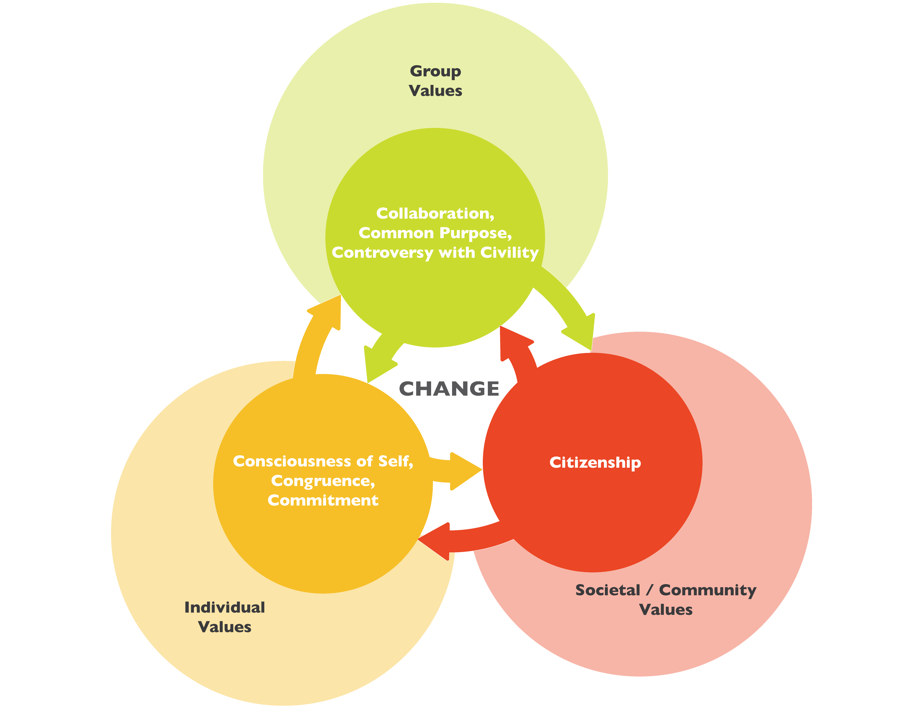
SIGNIFICANCE OF STUDY

Slide 4
RESEARCH QUESTIONS
To what extent, if any, does social networking _______ influence college students’ capacities for socially responsible leadership?
FREQUENCY
PROFICIENCY
CENTRALITY
how often one engages in social networking platforms (Smith & Anderson, 2018).
technological savvy allowing adaption to new technology quickly and effectively while demonstrating the ability to continue to expand technological knowledge (Ng, 2012).
the emotional connectedness and integration of social networking into one’s lifestyle (Ellison, Steinfield, & Lampe, 2007).
To what extent, if any, does the inclusion of social perspective-taking as an intermediate outcome shape the influence of social networking on college students’ capacities for socially responsible leadership?
SOCIAL PERSPECTIVE-TAKING
The ability to put oneself in the place of others and recognize that other individuals may have points of view different from one’s own (Johnson, 1975, p. 241).

Slide 5
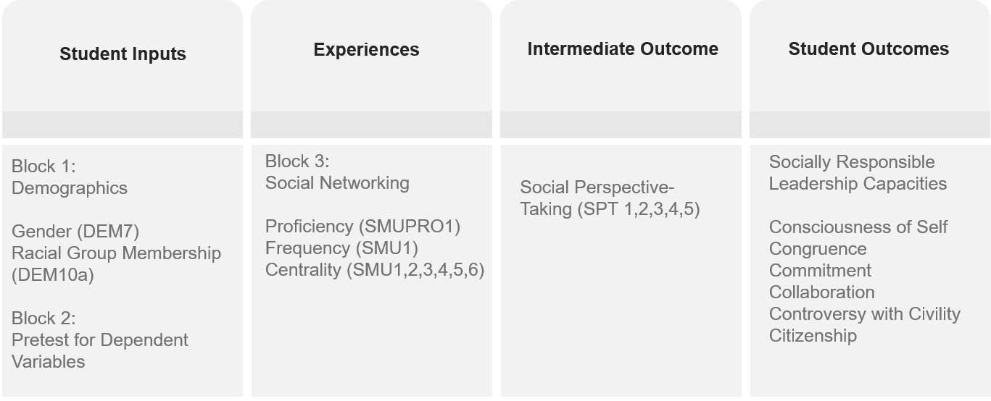
CONCEPTUAL FRAME
Basic Model: Demographics + Pretest + Social Networking
Intermediate Model: Demographics + Pretest + Social Networking + Social Perspective Taking
Full Range Model: Demographics + Pretest + Social Networking + High Impact Practices + Social Perspective Taking

Slide 6
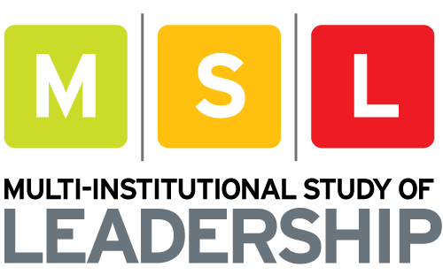
METHODS
SAMPLE SELECTION PARAMETERS
Quantitative
Cross-sectional
2018 Multi-Institutional Study of Leadership (MSL)
7 core scales
4 sub-studies
Collects:
Demographics
Pre-college experiences
College experiences
Cases where students completed less than 90% of the survey were removed
International students were omitted given cultural variation around the intermediate and outcome variables
Only students who identified as seniors were retained
Sample numbers were generated for race and gender and appropriately cleaned based on results
256,289
TOTAL SAMPLE SIZE
29%
NATIONAL RESPONSE RATE
54,430
COMPLETED CASES
14,564
CASES USED IN THIS RESEARCH

Slide 7
RESULTS & MAJOR CONCLUSIONS
 | Consciousness of Self | Congruence | Commitment | Collaboration | Controversy with Civility | Citizenship
Frequency |  | *** | *** |  | ***
Proficiency | *** | *** | *** | *** | *** | ***
Centrality |  | *** | *** |  | *** | ***
Social Perspective-Taking | *** | *** | *** | *** | *** | ***
Social Networking Matters to Socially Responsible Leadership
This study confirms a relationship between social networking and socially responsible leadership and demonstrates this relationship exists above and beyond known influences like high-impact practices and social perspective-taking.
01
Social Networking Proficiency: They Can (and Must) Be Taught!
02
Social Perspective-Taking and High-Impact Practices
03
Social Networking Centrality: A Concerning Influence
04
Recognizing the Complexity of Social Networking Frequency

Slide 8
We don't have a choice on whether we do
social networking, the choice is how well we do it.
Erik Qualman

Slide 9
REFERENCES
Ellison, N., Steinfield, C., & Lampe, C. (2007). The Benefits of Facebook “Friends:” Social Capital and College Students’ Use of Online Social Network Sites. Journal of Computer-Mediated Communication, 12(4), 1143–1168. https://doi.org/10.1111/j.1083-6101.2007.00367.x
Johnson, D. W. (1975). Cooperativeness and social perspective-taking. Journal of Personality and Social Psychology, 31(2), 241-244. http://dx.doi.org/10.1037/h0076285
Ng, W. (2012). Can we teach digital natives digital literacy? Computers & Education, 59, 1065–1078.
Smith, A., & Anderson, M. (2018, March 1). Social Media Use in 2018. Retrieved July 3, 2018, from http://www.pewinternet.org/2018/03/01/social-media-use-in-2018/
QUESTIONS AND DISCUSSION

